Slide 1
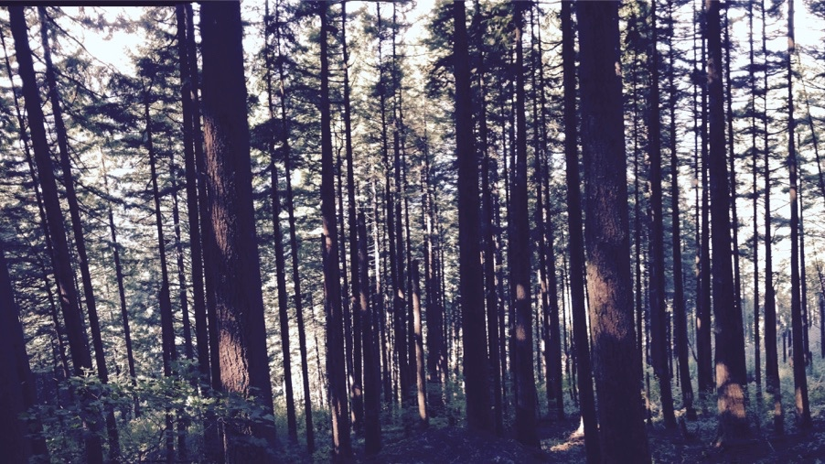
Thoughts on improving C₄ photosynthesis in TBMs
Nick Smith
w/ contributions from Helen Scott, Zinny Ezekannagha, Cameron Merryman, and USGS Powell Center C₄ working group
Department of Biological Sciences
Texas Tech University
nick.smith@ttu.edu

Slide 2
Quick physiology reminders
nick.smith@ttu.edu

Slide 3
Photorespiration
nick.smith@ttu.edu

Slide 4
Photorespiration
nick.smith@ttu.edu
Rubisco : RibUlose – 1,5 – BISphosphate Carboxylase and Oxygenase
Catalyzes CO₂ and O₂
Catalyzing O₂ leads to “wasteful” respiration (loss of CO₂)
Increases as O₂ increases
Increases with temperature

Slide 5
2 types of photosynthesis systems in TBMs
nick.smith@ttu.edu
C₃: Most plants
C₄: Separate carbon acquisition and sugar creation in space

Slide 6
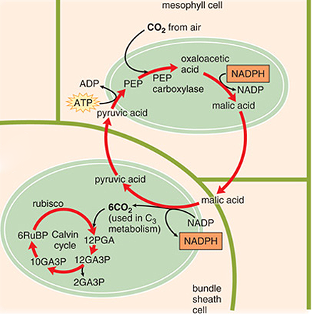
C₄ photosynthesis
nick.smith@ttu.edu
PEP carboxylase captures CO₂ and creates a 4 carbon sugar in mesophyll
Moves sugar to bundle sheath, where CO₂ is removed
Bundle sheath cells surround veins
Calvin cycle progresses as normal
“Costs” a little extra ATP

Slide 7
C₄ photosynthesis - benefits
nick.smith@ttu.edu
PEP carboxylase is not an oxygenase
Good at capturing CO₂
Good in low CO₂ environments
Good in hot, dry environments
Can close stomata

Slide 8
Current representation of C₄ photosynthesis in TBMs
nick.smith@ttu.edu

Slide 9
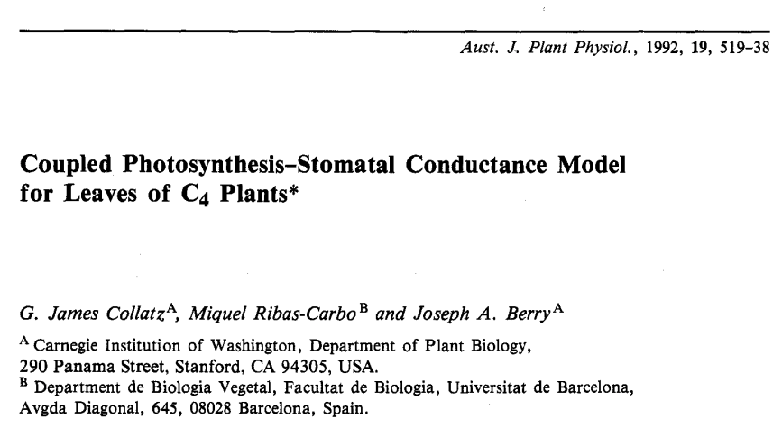
nick.smith@ttu.edu

Slide 10
Collatz et al. (1992)
nick.smith@ttu.edu
Photosynthesis is limiting rate of three processes:
Rubisco carboxylation (A_{c})
Light-related processes (A_{j})
PEP carboxylation (A_{p})
Governing equations
A_{c} = V_{cmax,25} * f(T_{leaf})
A_{j} = φI
A_{p} = k_{p,25} * f(T_{leaf}) * C_{i}

Slide 11
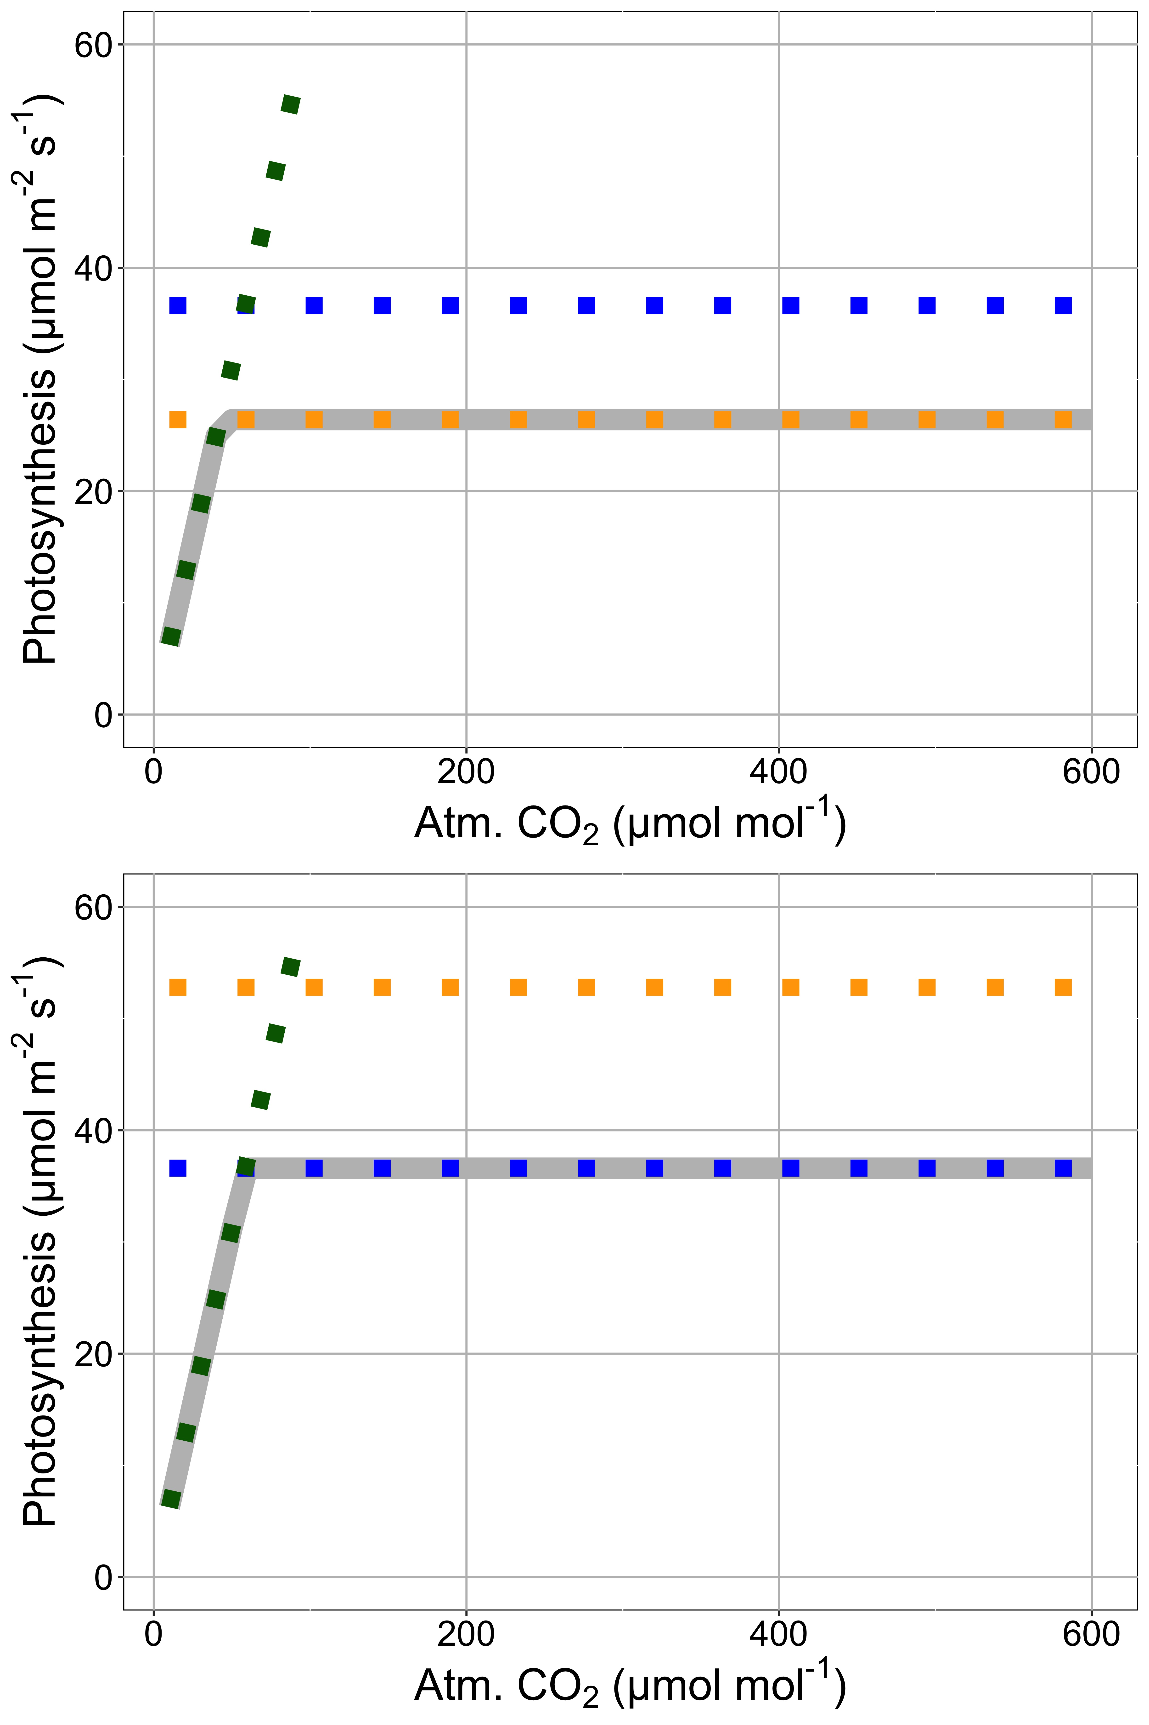
Collatz model instantaneous CO₂ responses
nick.smith@ttu.edu
Low light (PAR = 500)
Rubisco carboxylation (A_{c})
Light-related processes (A_{j})
PEP carboxylation (A_{p})
High light (PAR = 1000)

Slide 12
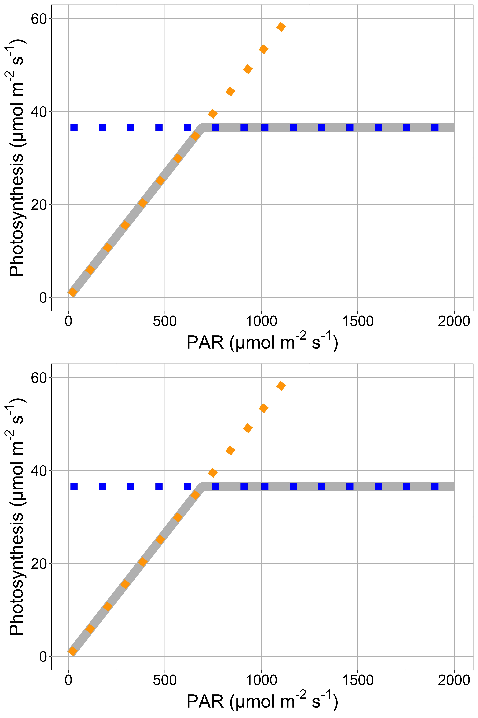
Collatz model instantaneous light responses
nick.smith@ttu.edu
Low CO₂ (400 ppm)
Rubisco carboxylation (A_{c})
Light-related processes (A_{j})
PEP carboxylation (A_{p})
High CO₂ (1000 ppm)

Slide 13
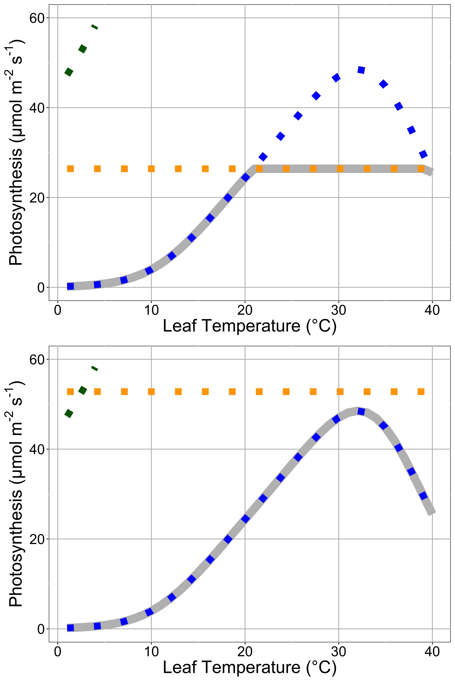
Collatz model instantaneous temperature responses
Low light (PAR = 500)
nick.smith@ttu.edu
Rubisco carboxylation (A_{c})
Light-related processes (A_{j})
PEP carboxylation (A_{p})
High light (PAR = 1000)

Slide 14
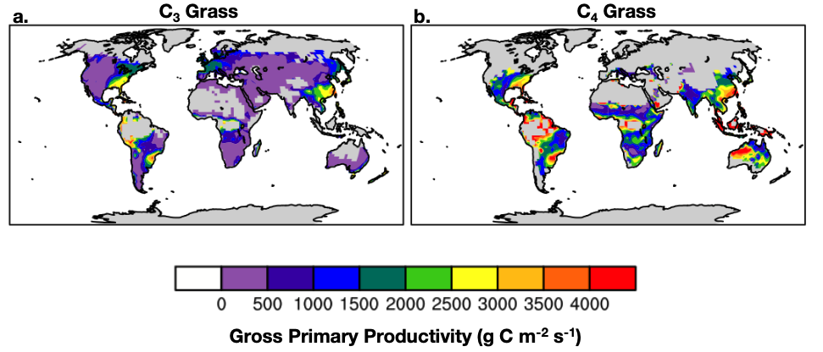
C₄ grasses can be rather productive in ESMs
nick.smith@ttu.edu

Slide 15
Collatz model issues
nick.smith@ttu.edu

Slide 16
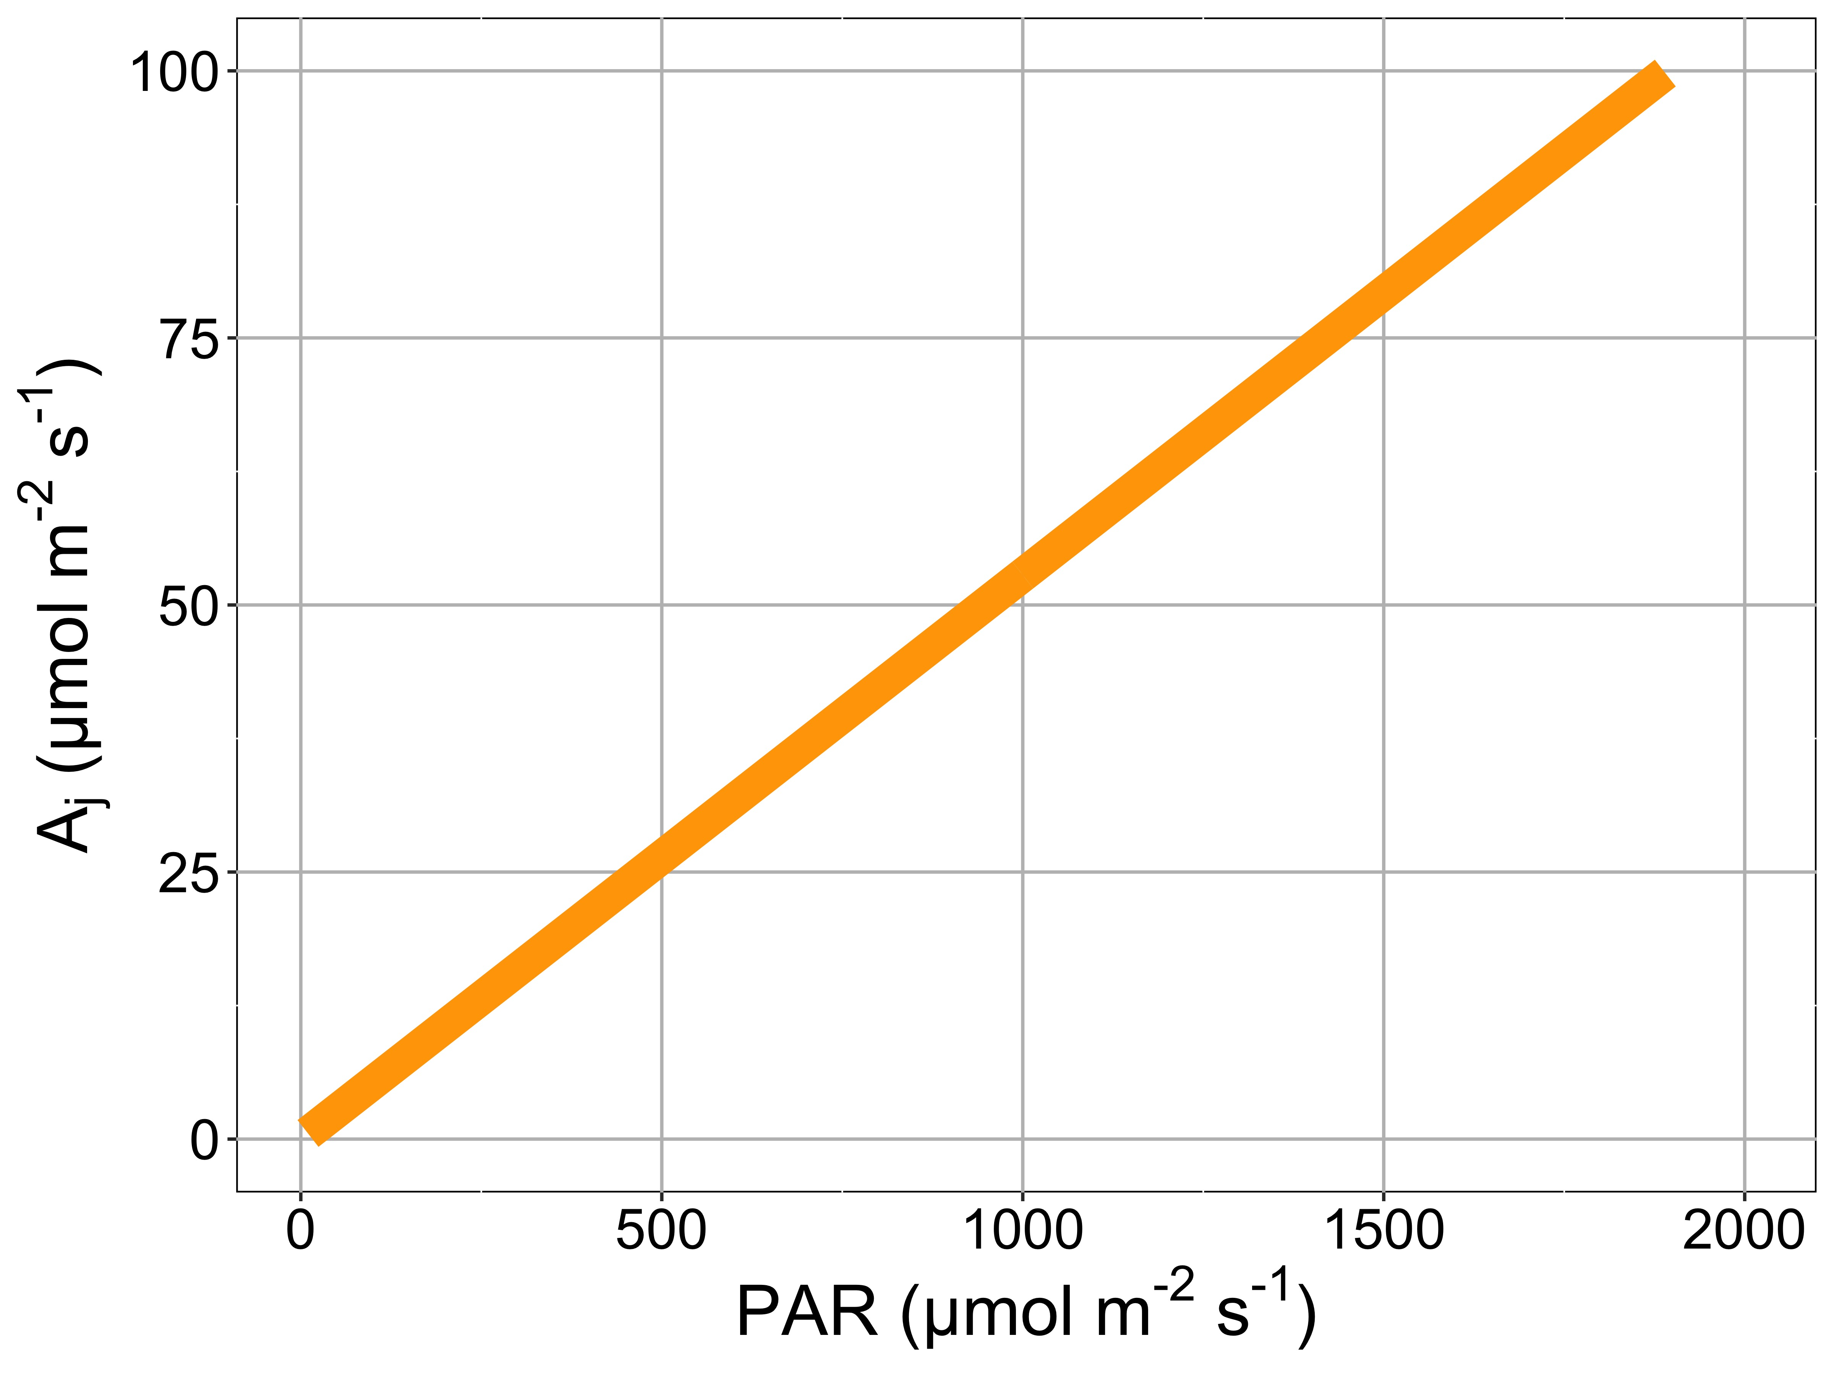
Issue 1: light response
nick.smith@ttu.edu
Non-mechanistic linear light response

Slide 17
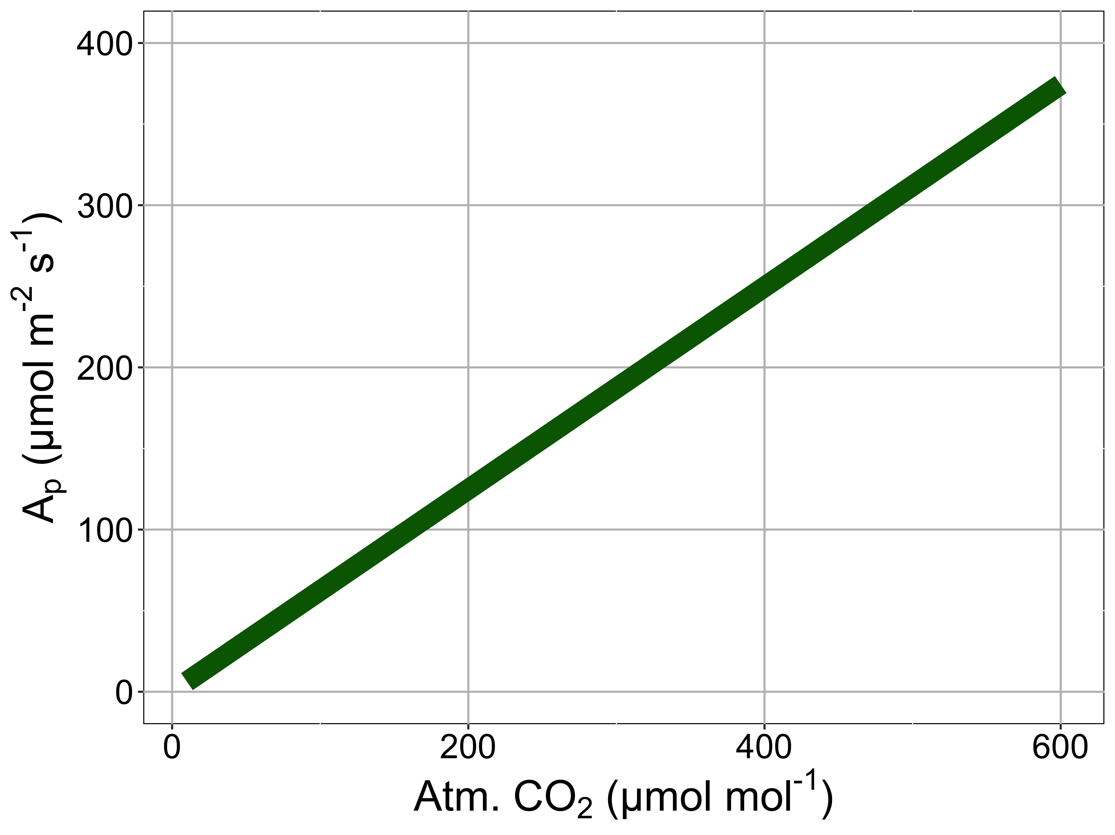
Issue 2: PEP response
nick.smith@ttu.edu
Linear, no CO₂ saturation (no M-M kinetics)

Slide 18
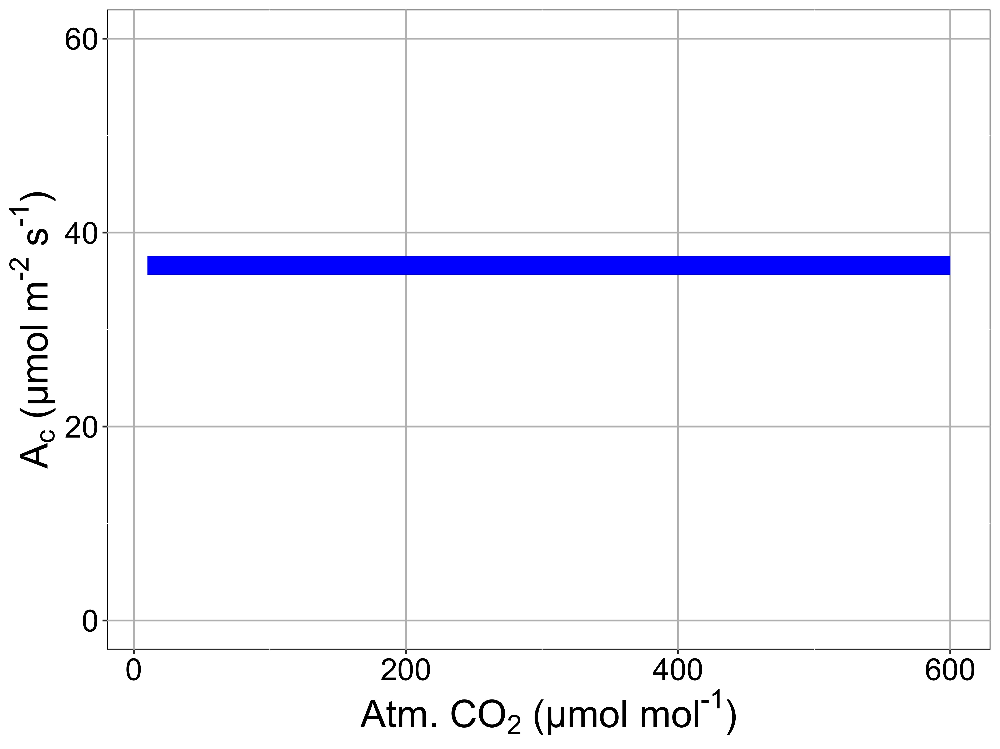
Issue 3: Rubisco response
nick.smith@ttu.edu
No oxygenation or K_{m}, Rubisco assumed to be saturated with CO₂

Slide 19
Issue 4: Carbon
nick.smith@ttu.edu
No transfer of carbon between mesophyll and bundle sheath (i.e., no bundle sheath conductance or leakage)
plantphysiol.org

Slide 20
Issue 5: parameterization
nick.smith@ttu.edu
Parameters are from 21 measurements on potted, fertilized Z. mays

Slide 21
A proposed way forward
nick.smith@ttu.edu

Slide 22
Previous models offer ways to address some of the current issues in ESMs
nick.smith@ttu.edu

Slide 23
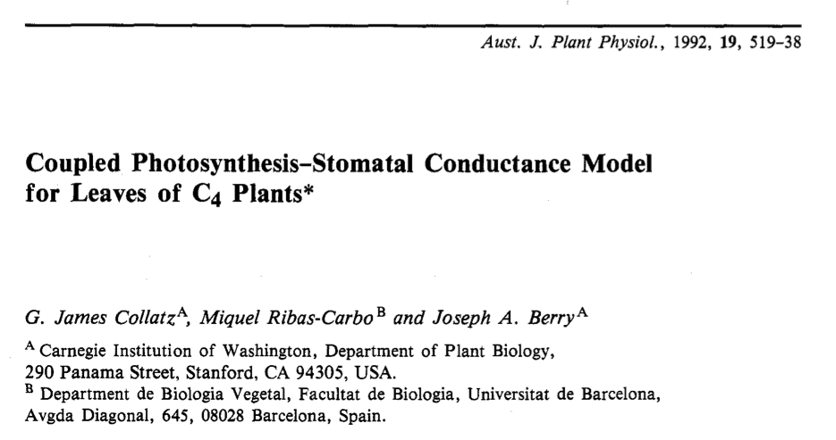
Previous models offer ways to address some of the current issues in ESMs
nick.smith@ttu.edu
Appendix has mods for including:
Full PEP M-M kinetics
Full Rubisco M-M kinetics
Oxygenation
Leakage
BS conductance

Slide 24
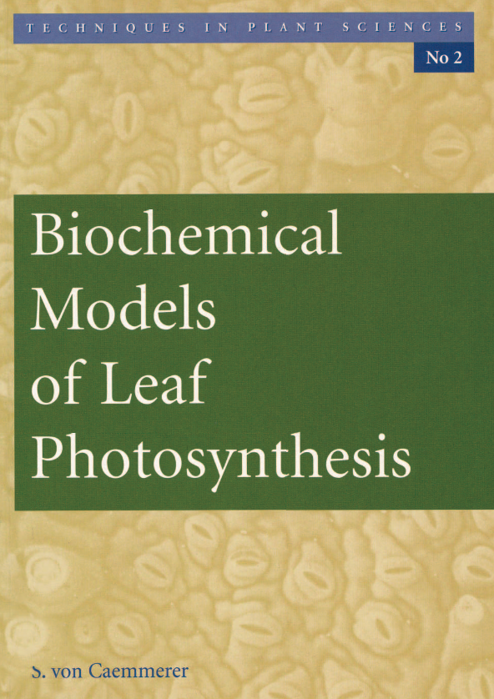
Previous models offer ways to address some of the current issues in ESMs
nick.smith@ttu.edu
Chapter 4 has mods for:
Full PEP M-M kinetics
Full Rubisco M-M kinetics
Oxygenation
Leakage
BS conductance
Light dependence of electron transport
Von Caemmerer (2000), and updated in Von Caemmerer (2022)

Slide 25
Previous models offer ways to address some of the current issues in ESMs
nick.smith@ttu.edu
Chapter 4 has mods for:
Full PEP M-M kinetics
Full Rubisco M-M kinetics
Oxygenation
Leakage
BS conductance
Light dependence of electron transport
**All limit C4 photosynthesis relative to Collatz (1992)**
Von Caemmerer (2000), and updated in Von Caemmerer (2022)

Slide 26
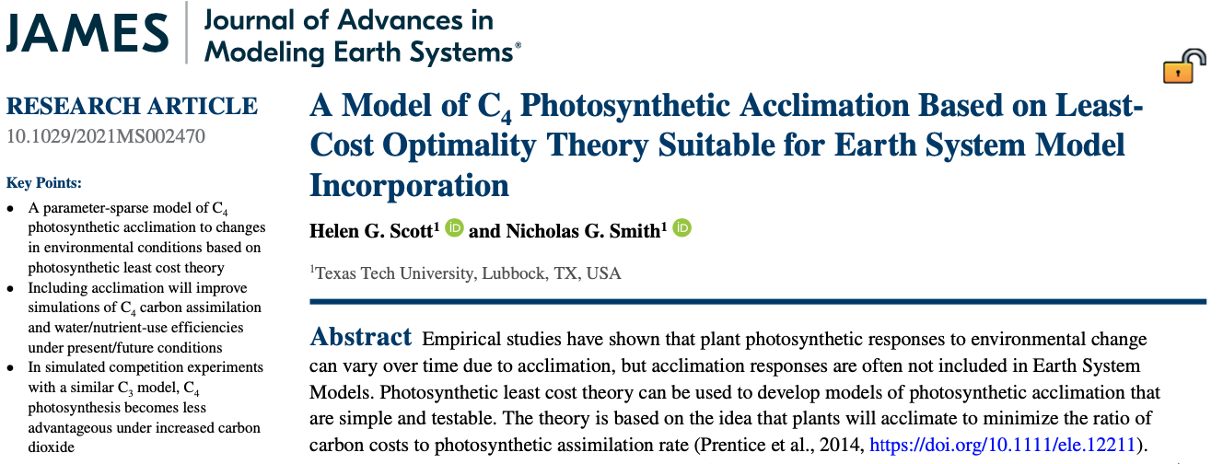
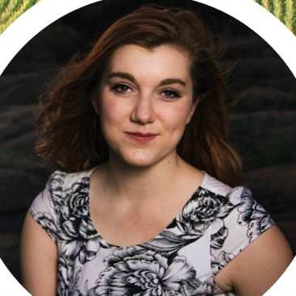
New model (Scott and Smith, 2022)
nick.smith@ttu.edu
Helen Scott, TTU (now at BU)

Slide 27
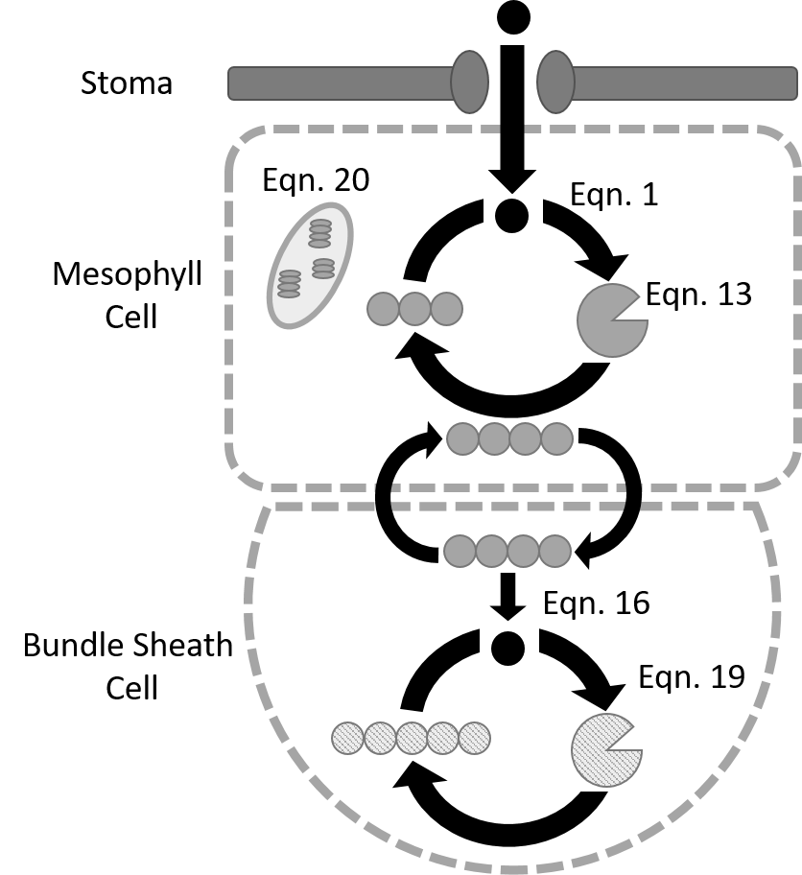
New C₄ model features
nick.smith@ttu.edu
Von Caemmerer (2000)
Maximum PEP carboxylation
Rubisco kinetics
Oxygenation
Leakage
BS conductance
Light dependence of electron transport
Scott and Smith (2022)

Slide 28
New C₄ model features
nick.smith@ttu.edu
Least cost acclimation
PEP carboxylation
Rubisco carboxylation
Electron transport
Stomatal conductance
Scott and Smith (2022)

Slide 29
Least cost theory
nick.smith@ttu.edu
Maintain fastest rate of photosynthesis at the lowest cost (water and nutrient use)
Wright et al. (2003) American Naturalist

Slide 30
Biochemistry optimization: Coordination hypothesis
nick.smith@ttu.edu
Optimal setup = equal limitation by all factors

Slide 31
Optimally: electron transport-limited (A_{j}) = Rubisco-limited (A_{c}) = PEP-limited (A_{p})
nick.smith@ttu.edu
A_{j} = A_{c} = A_{p}
Scott and Smith (2022)

Slide 32
Optimally: electron transport-limited (A_{j}) = Rubisco-limited (A_{c}) = PEP-limited (A_{p})
nick.smith@ttu.edu
A_{j} = A_{c} = A_{p}
A_{j} = f{J_{max}, light, T, CO₂}
A_{c} = f{V_{cmax}, T, CO₂}
A_{p} = f{V_{pmax}, T, CO₂}
Scott and Smith (2022)

Slide 33
nick.smith@ttu.edu
Can rearrange the formulas to solve for acclimated traits
V_{cmax}
J_{max}
V_{pmax}
Scott and Smith (2022)

Slide 34
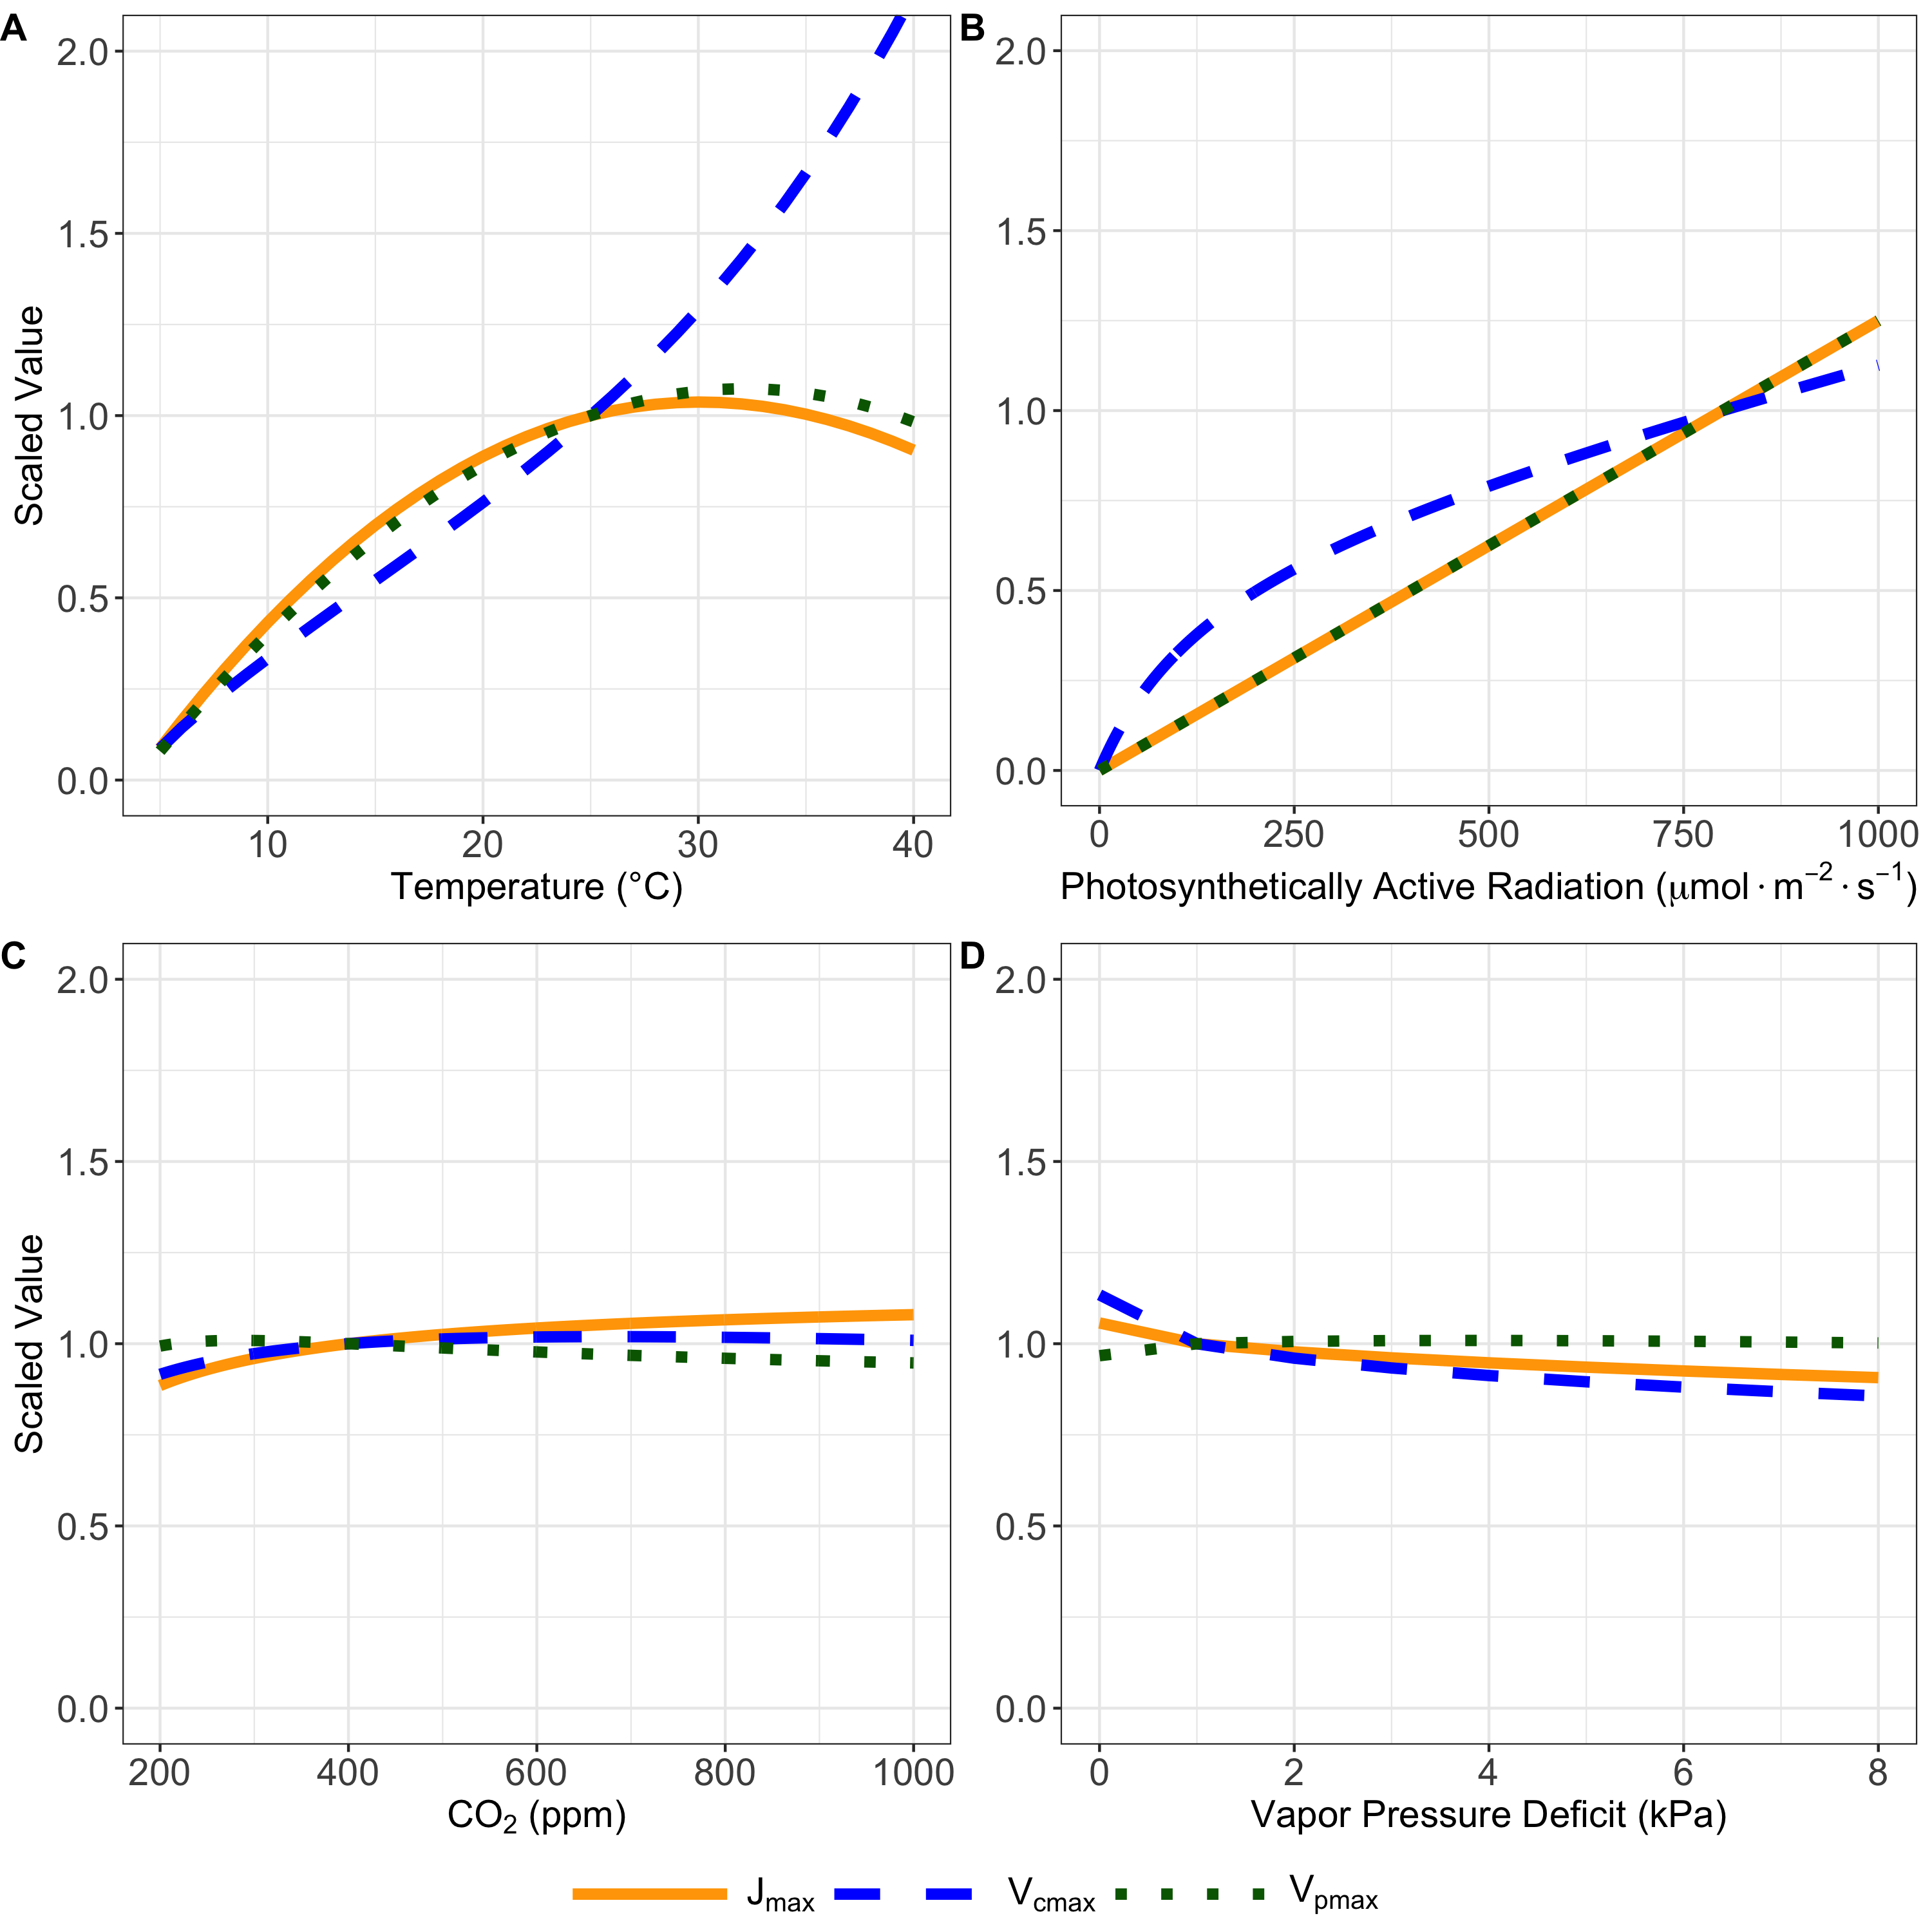
nick.smith@ttu.edu
More light = more investment in biochemical processes
Scott and Smith (2022)

Slide 35
nick.smith@ttu.edu
More CO₂ = less investment in PEP, more in electron transport
Scott and Smith (2022)

Slide 36
nick.smith@ttu.edu
Higher T = faster rates, but less investment (not shown)
Scott and Smith (2022)

Slide 37
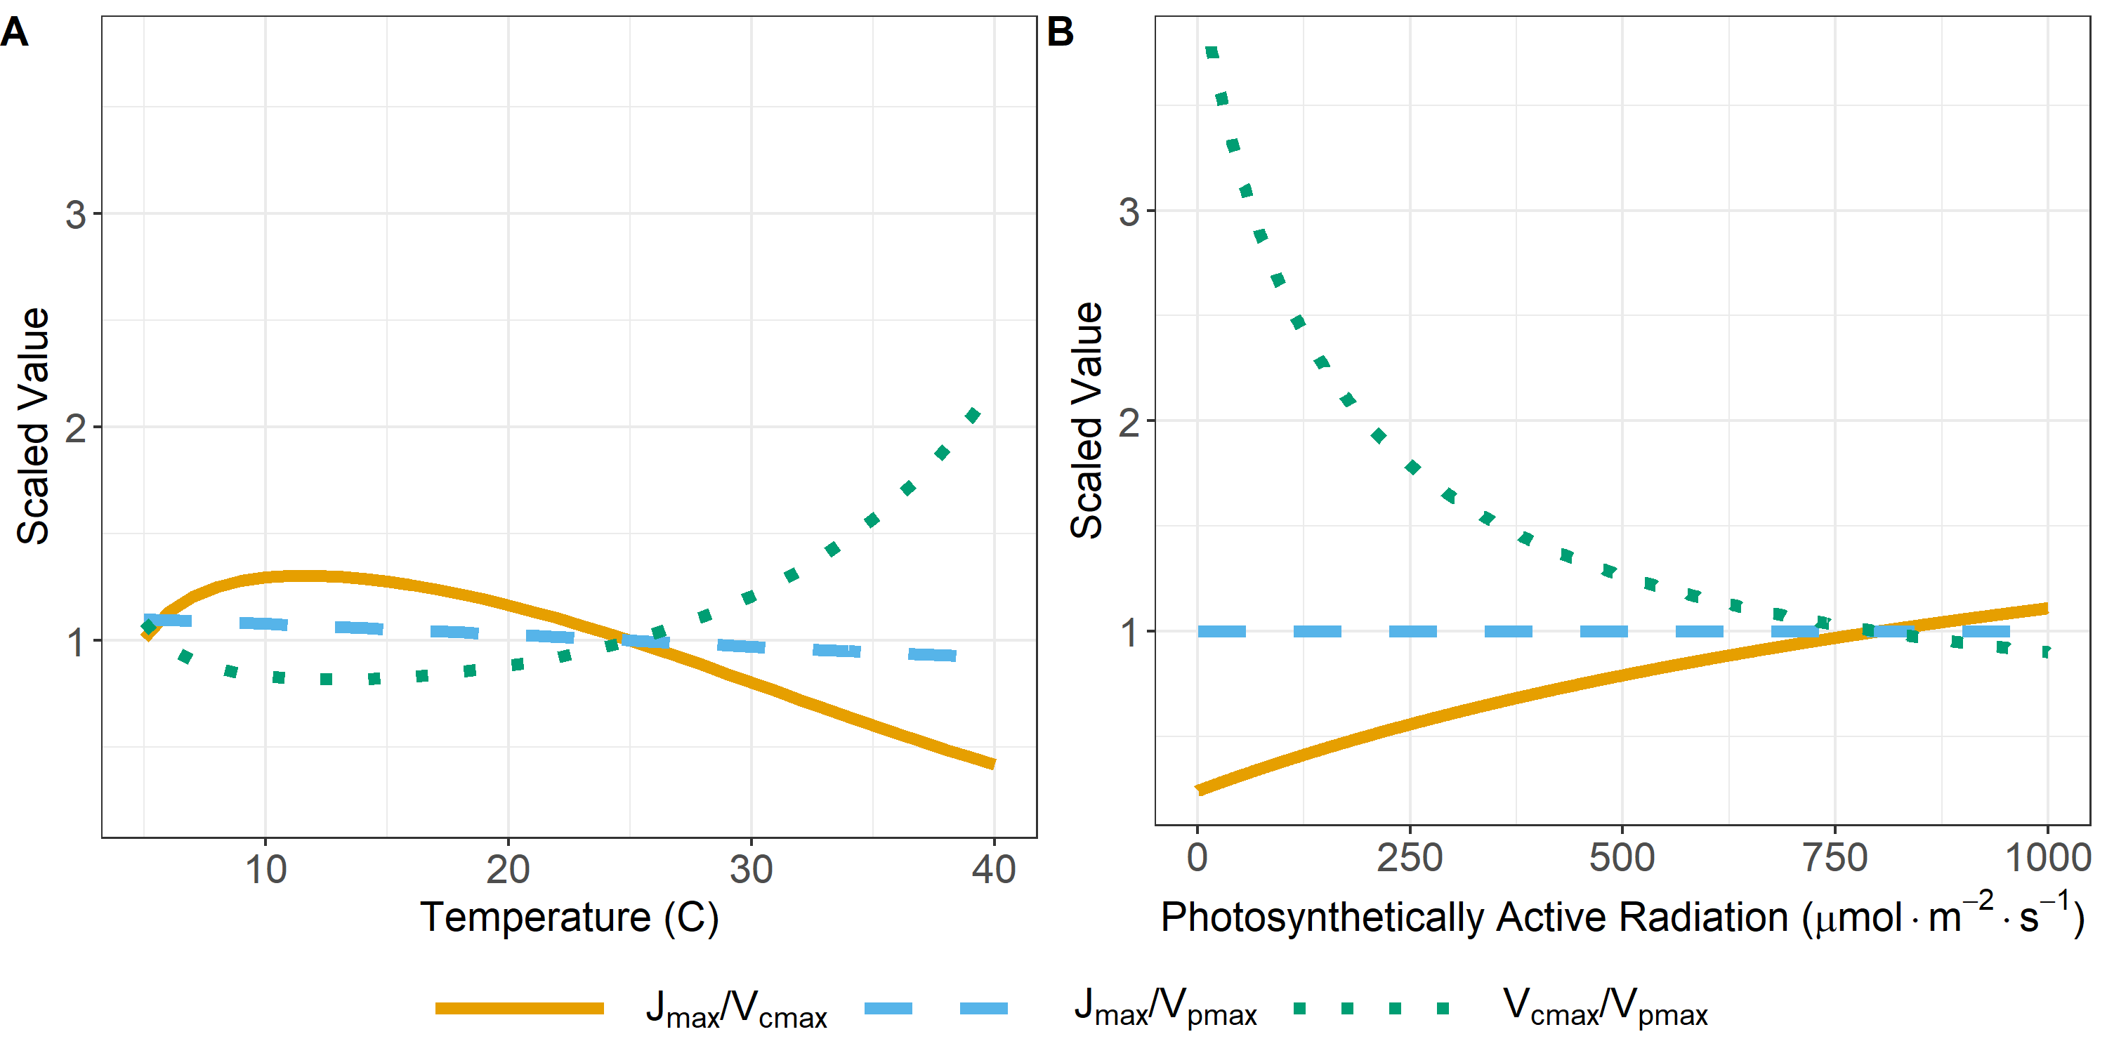
nick.smith@ttu.edu
Can look at changes in relative investment
Scott and Smith (2022)

Slide 38
Does it work?
nick.smith@ttu.edu

Slide 39
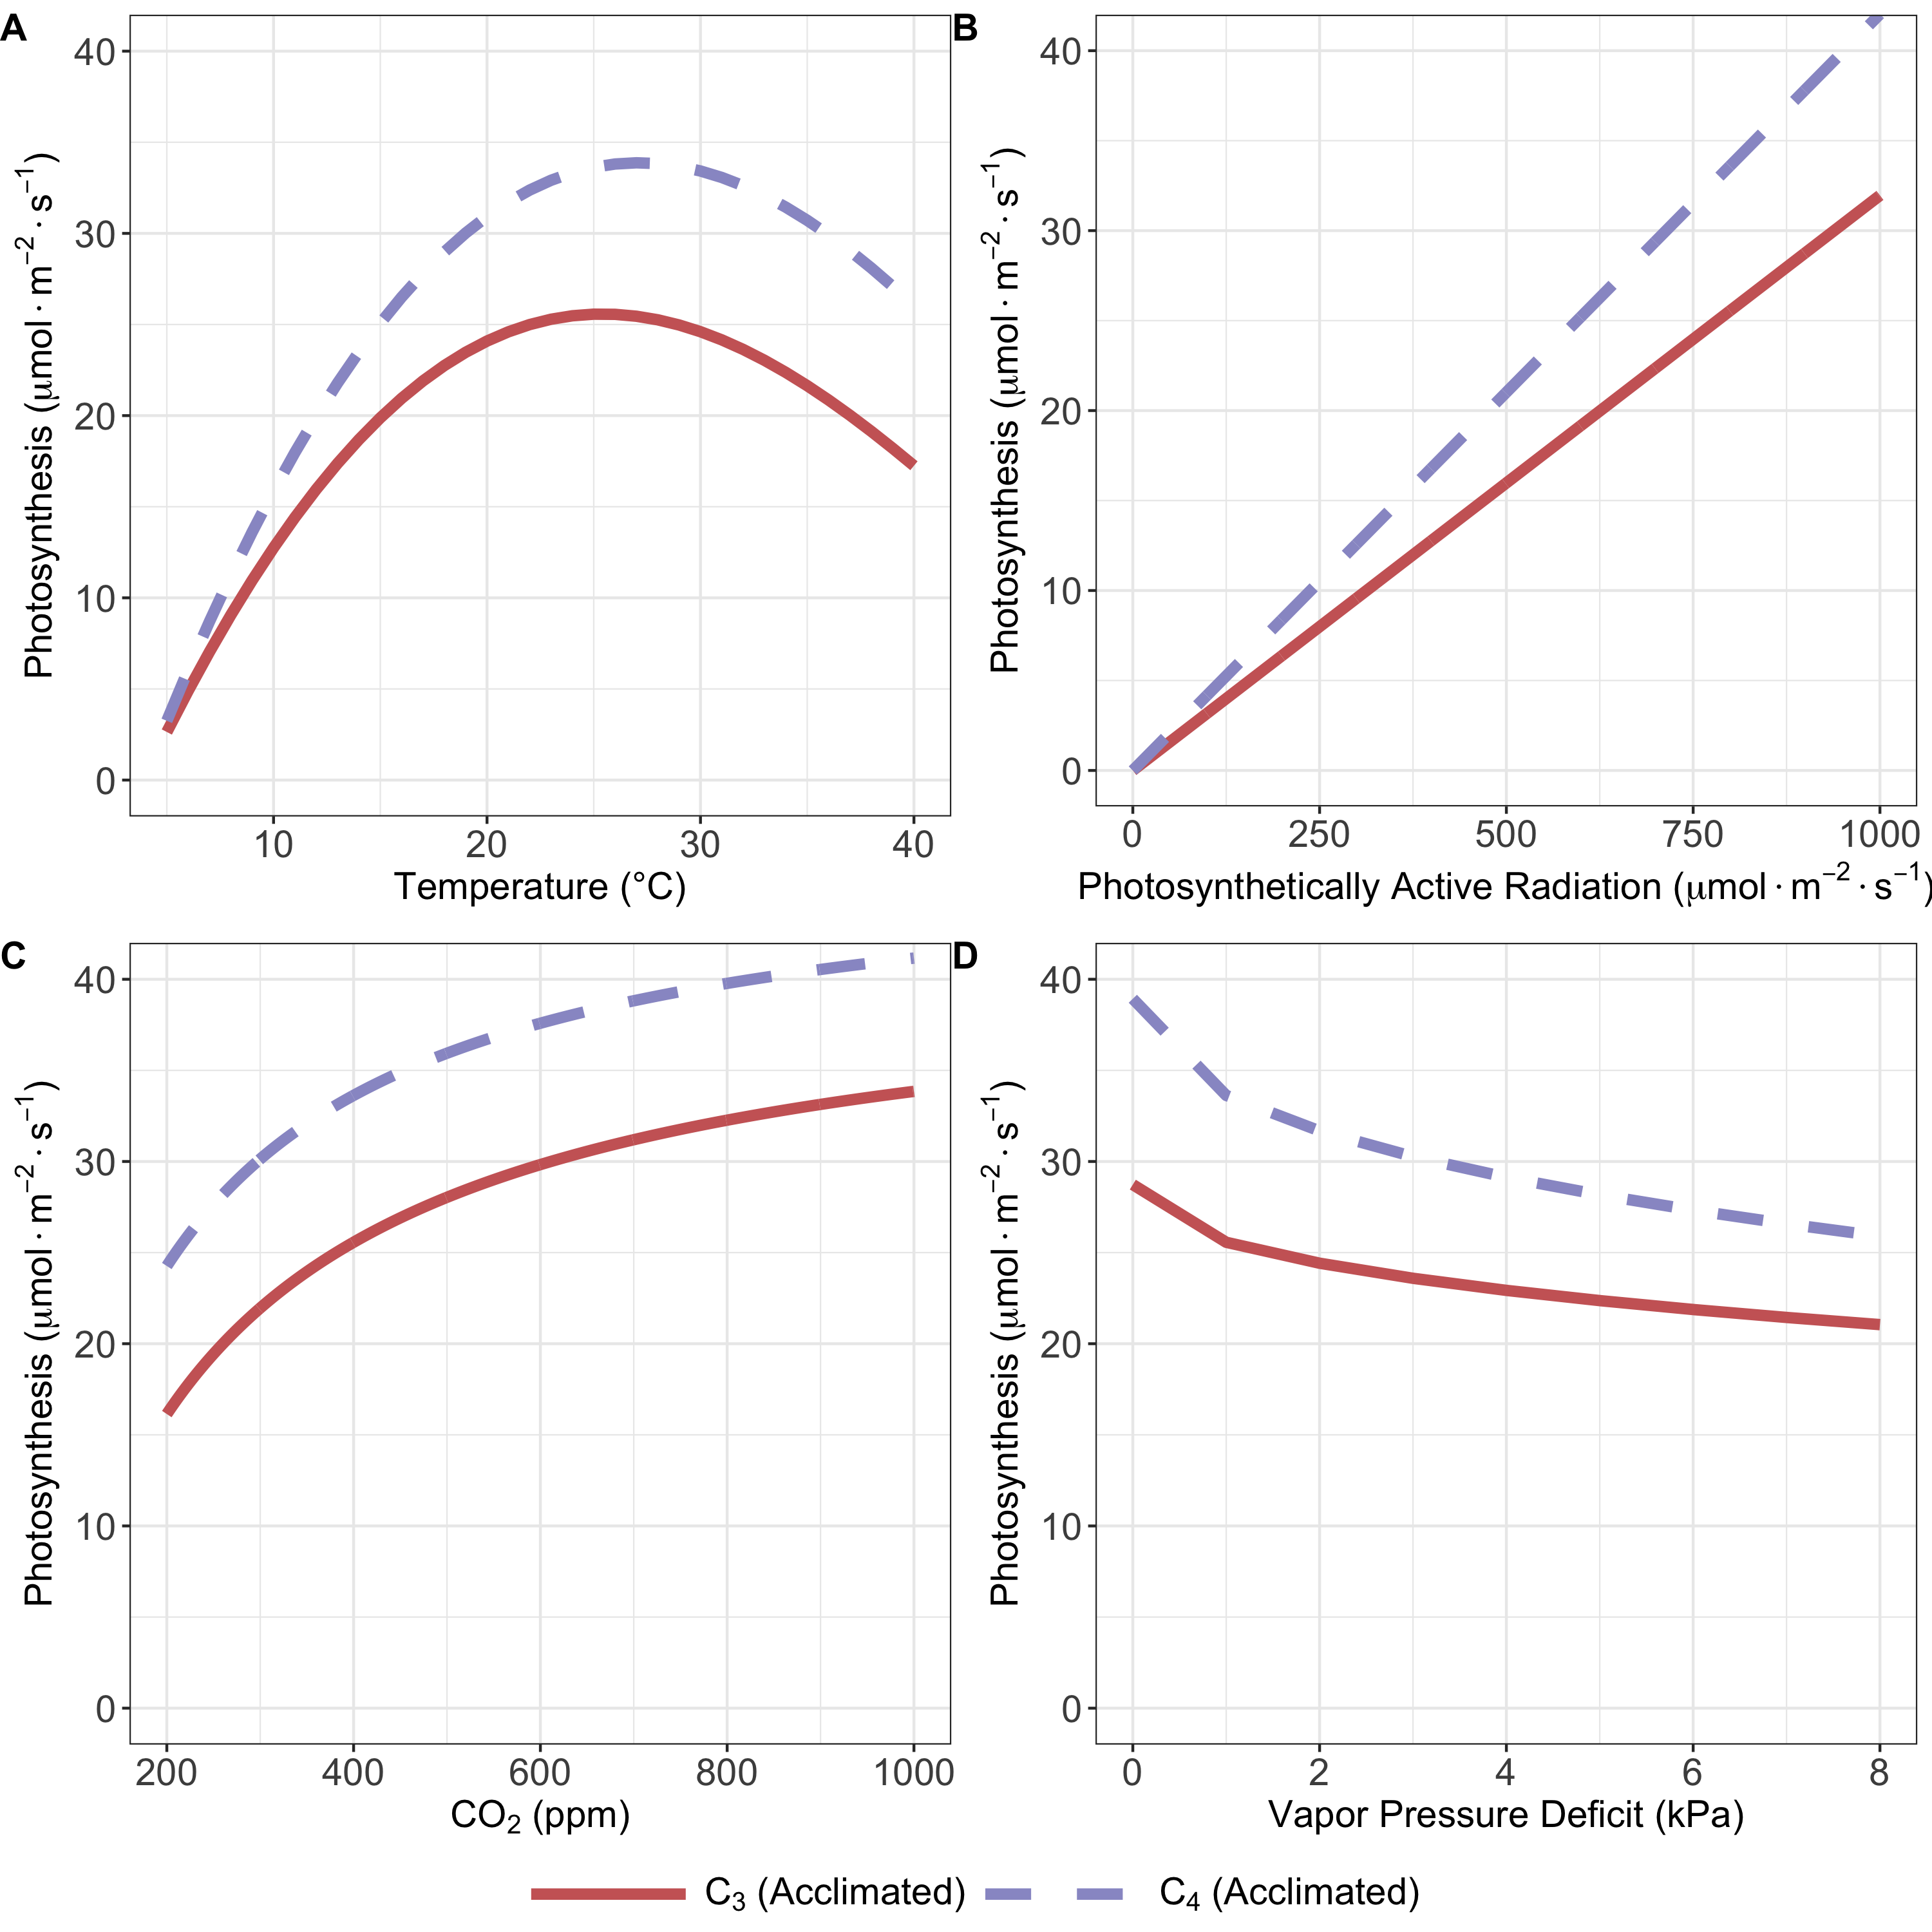
Maybe?
nick.smith@ttu.edu
20% benefit at 5°C to
40% benefit at 35°C
As expected, C₄ species are most benefitted under hot, low CO₂ conditions
50% benefit at 200 ppm to
20% benefit at 1000 ppm
Scott and Smith (2022)

Slide 40
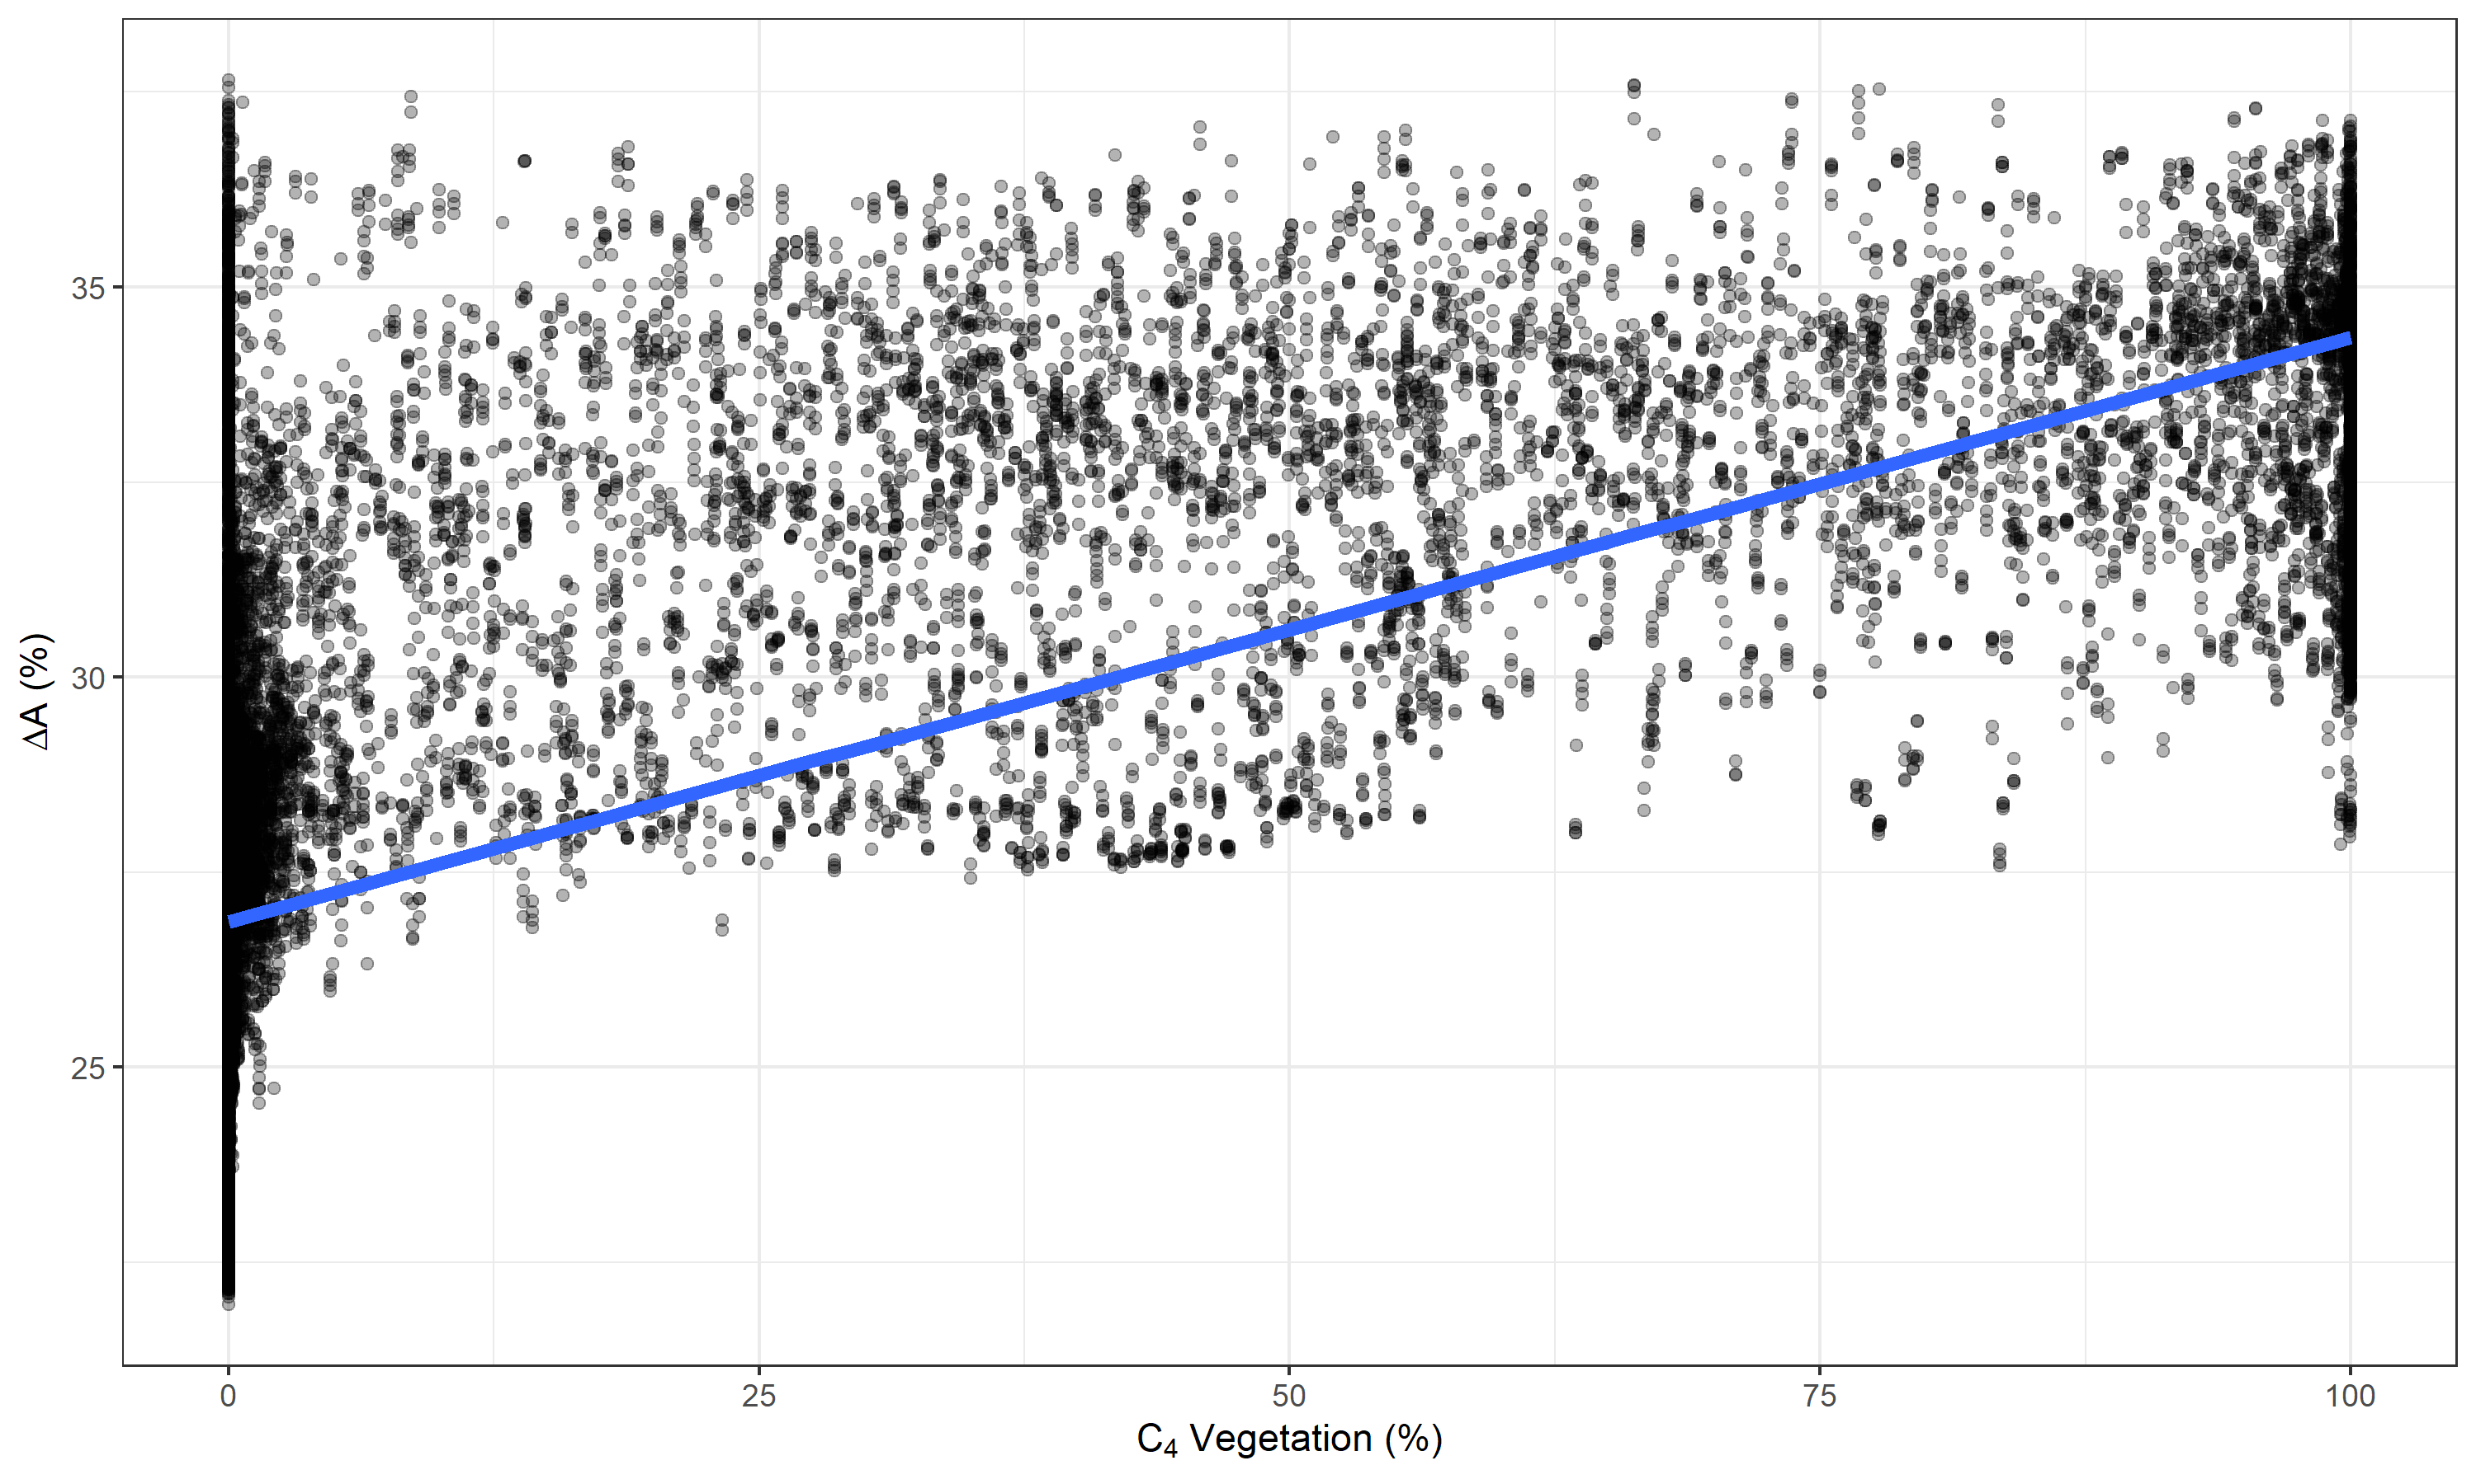
Maybe?
nick.smith@ttu.edu
The model tends to predict where C₄ species dominate
Still et al. (2003)
Scott and Smith (2022)

Slide 41
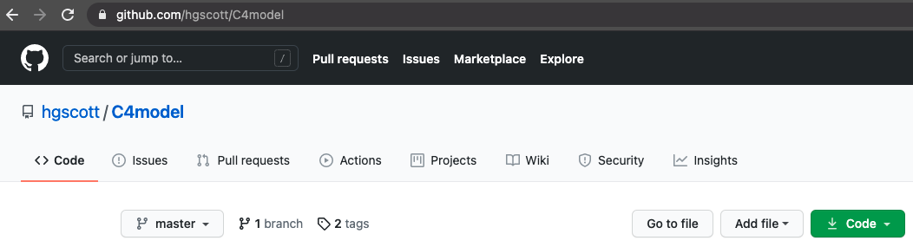
Model considerations
nick.smith@ttu.edu
Parameters to incorporate soil water and nutrients (fixed at the moment)
Need better light harvesting equations
Could be used for ESM incorporation and/or asking ecological questions
github.com/hgscott/C4model (doi: 10.5281/zenodo.4420326)

Slide 42
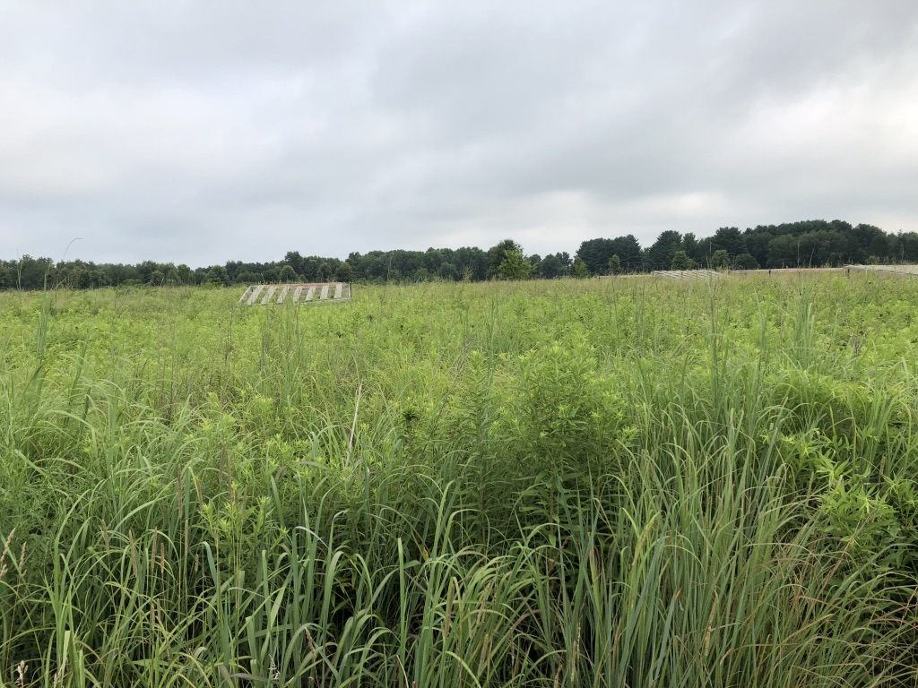
Conclusions and future considerations
nick.smith@ttu.edu
Probably time to move away from simplistic representations of C₄ photosynthesis

Slide 43
Conclusions and future considerations
nick.smith@ttu.edu
Probably time to move away from simplistic representations of C₄ photosynthesis
Unclear what the model-to-model variability is
Rogers et al. (2017) for C4?

Slide 44
Conclusions and future considerations
nick.smith@ttu.edu
Probably time to move away from simplistic representations of C₄ photosynthesis
Unclear what the model-to-model variability is
Rogers et al. (2017) for C4?
Unclear all the options that exist
Whether they make a difference

Slide 45
Conclusions and future considerations
nick.smith@ttu.edu
Probably time to move away from simplistic representations of C₄ photosynthesis
Unclear what the model-to-model variability is
Rogers et al. (2017) for C4?
Unclear all the options that exist
Whether they make a difference
Need more data to test different models

Slide 46
Conclusions and future considerations
nick.smith@ttu.edu
Probably time to move away from simplistic representations of C₄ photosynthesis
Unclear what the model-to-model variability is
Rogers et al. (2017) for C4?
Unclear all the options that exist
Whether they make a difference
Need more data to test different models
Beyond leaf photosynthesis
Phenology
Allocation
”Strategies” (e.g., fire adaptations)

Slide 47
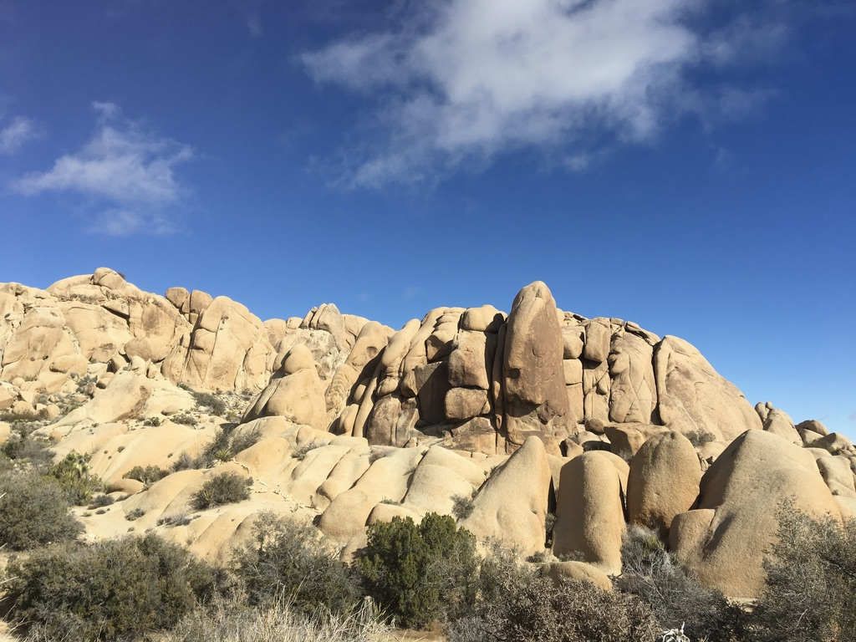
nick.smith@ttu.edu
Presentation available at github.com/smithecophyslab/seminar/2023_fates
Thanks!

